Slide 1




ODOP CHATBOT
Presented By:- Shivam and Isha

Slide 2
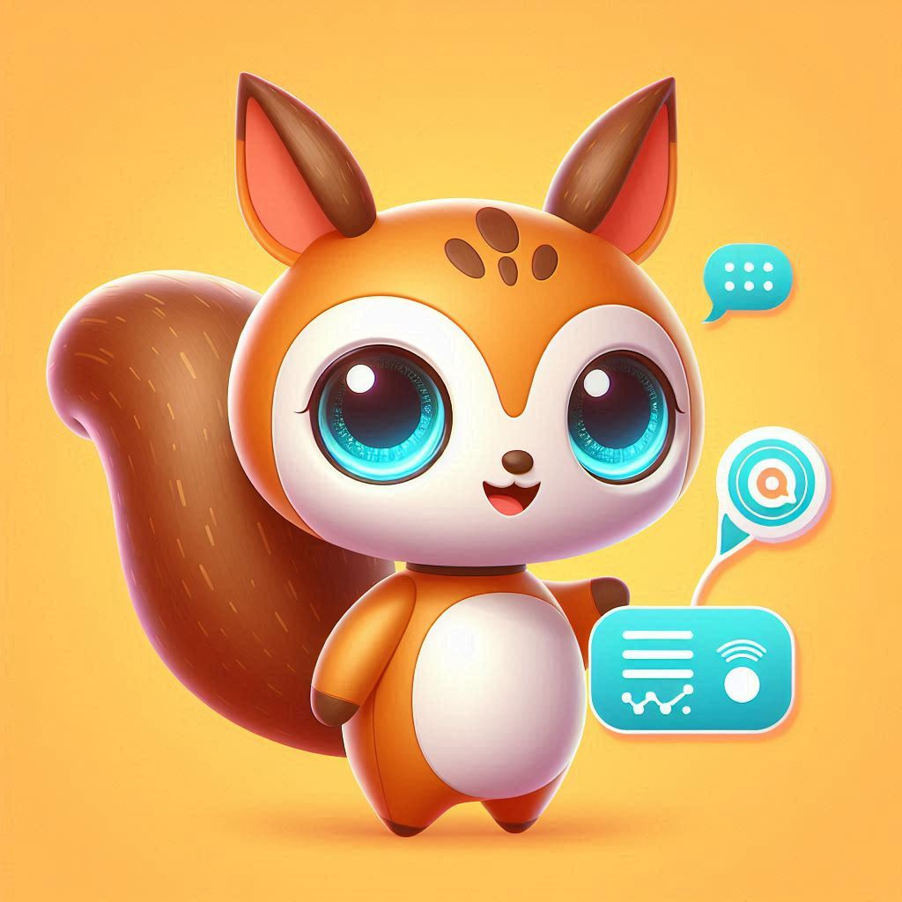
I’M ZUZU, YOUR VIRTUAL LIAISON FOR
SEAMLESS INTERACTION.

Slide 3
PROJECT INTRODUCTION
Introducing Zuzu, an AI assistant chatbot enhancing India's ODOP initiative. Zuzu provides detailed information on district-specific products , supporting local producers and connecting them with consumers. By bridging gaps, Zuzu promotes India's diverse heritage and aids regional economic development.

Slide 4
DATASET
Zuzu provides comprehensive data on each state's districts, products. This tool supports local producers, connects them with product’s origin, and promotes regional economic development by highlighting India's diverse heritage.

Slide 5
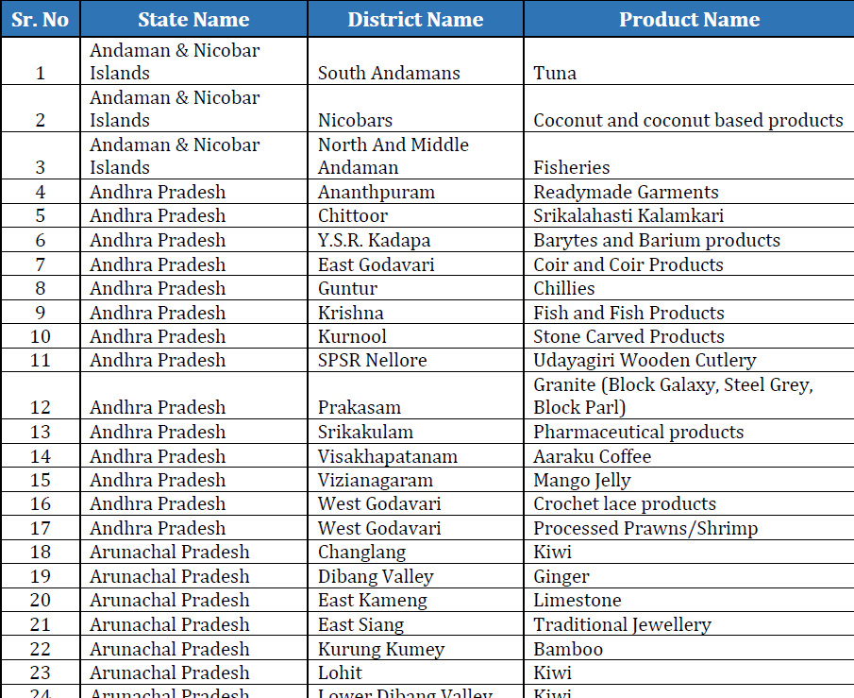
This is the data of products produce by each district of every state.

Slide 6
BOTPRESS
Botpress is an open-source conversational AI platform for building and managing chatbots and virtual assistants. It offers a visual flow editor, NLU support, and integrations with popular messaging platforms. Botpress empowers developers to create sophisticated bots with ease, fostering seamless interactions between businesses and users.

Slide 7
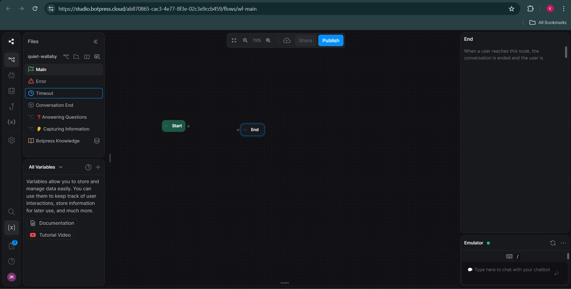
Interface of Botpress

Slide 8
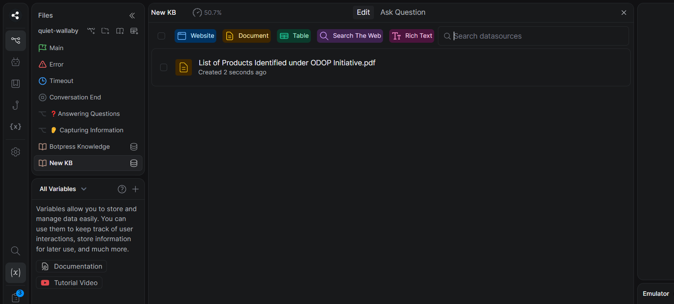
upload the file of data inknowledge base

Slide 9
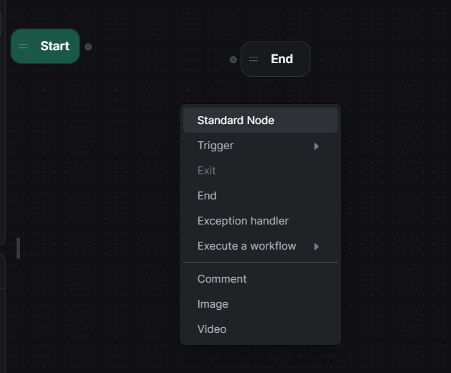
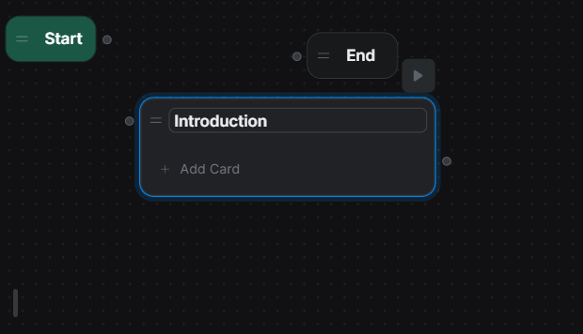
Node Chart:
A node chart is a visual representation of the flow of conversation within your chatbot. It illustrates how nodes are connected to each other and the logic that governs the interaction between the bot and the user.
Standard Nodes:
Used for sending messages to the user, such as text, images, buttons, or other rich media. Can include dynamic content and variables to personalize messages.
Rename:
rename the name of Standard node

Slide 10
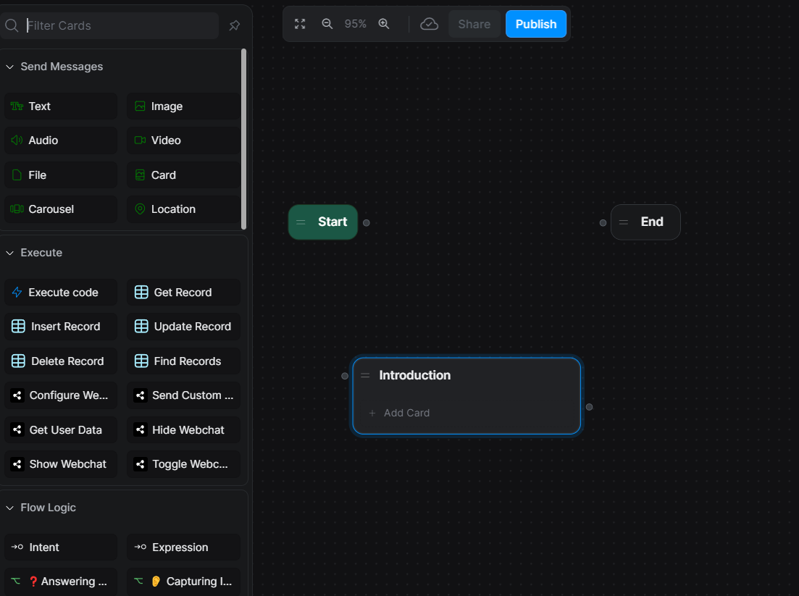
To add a cart functionality in a chatbot, integrate a "Cart" node within the flow. Utilize actions to manage cart items, quantities, and prices dynamically. Allow users to add, remove, and modify items in their cart seamlessly.

Slide 11
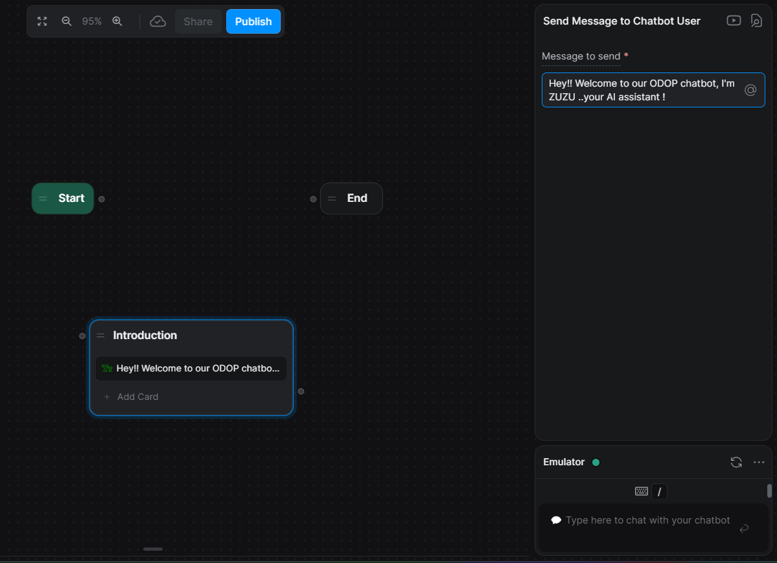
Add a text cart for welcoming or greeting the user.

Slide 12
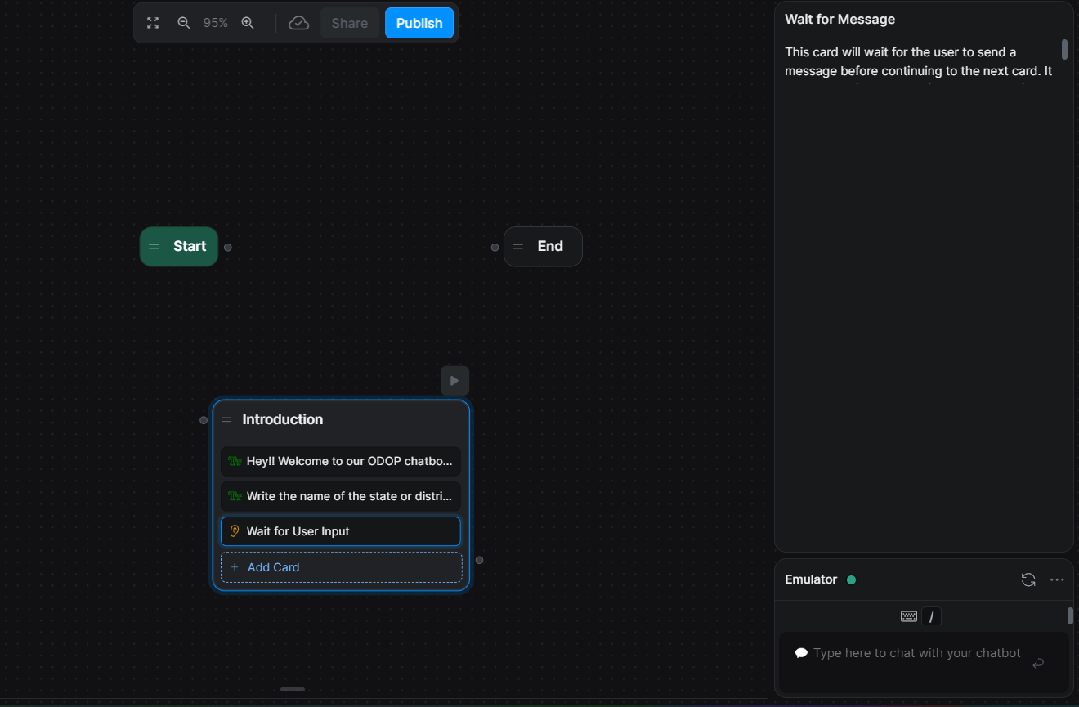
Add a cart which waits for user input

Slide 13
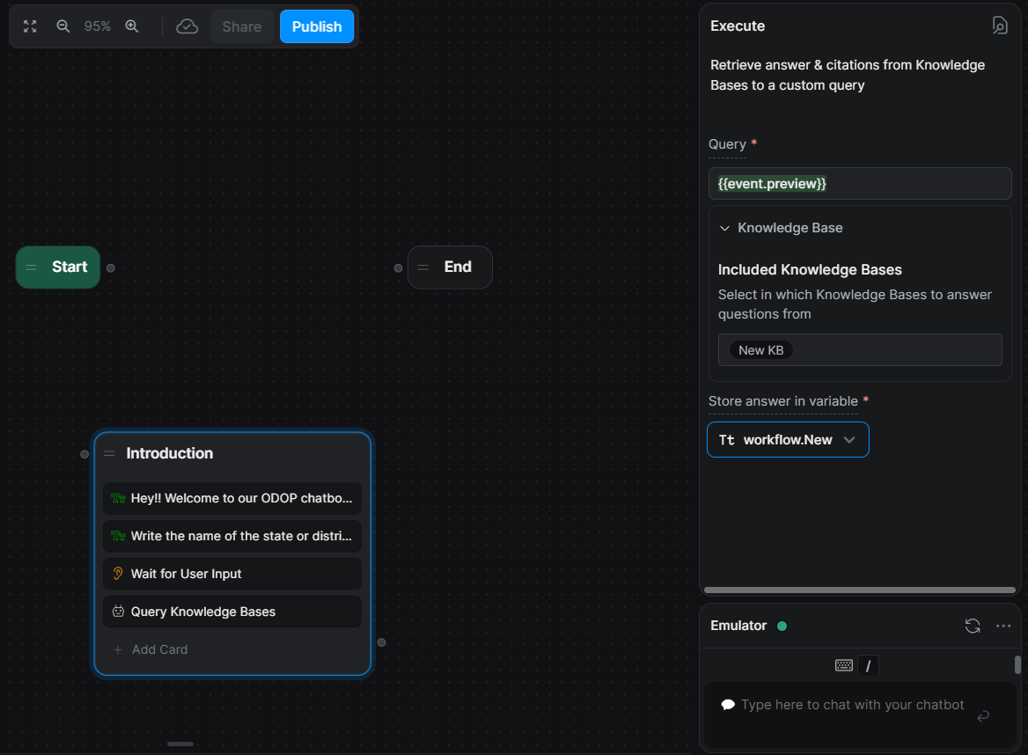
After getting input from user, this will go to knowledge base to check the query and fetch the output.
*set Query,*set knowledge base ,*store the ans in user defined variable(New).

Slide 14
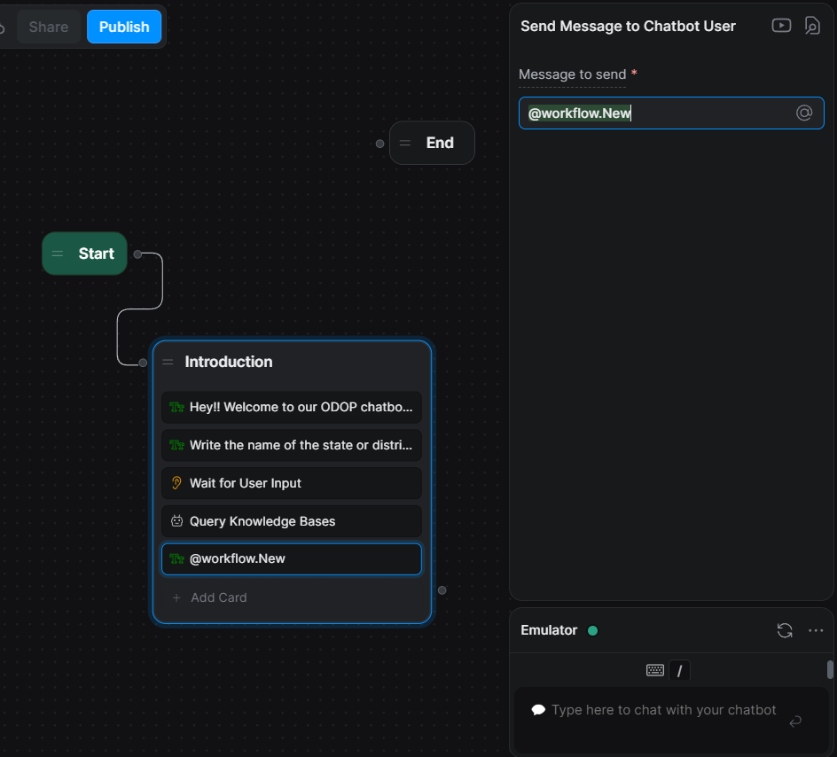
By text cart we provide message by response variable.
this will gives us output.

Slide 15
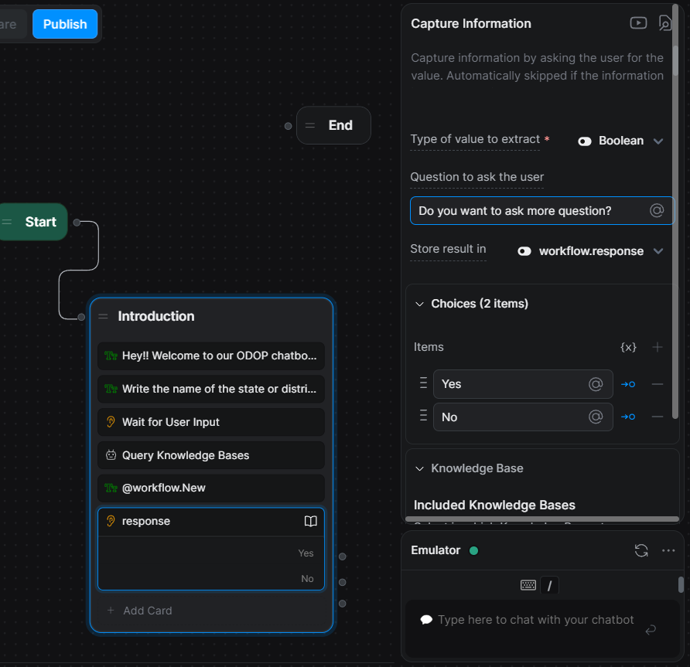
Now Add boolean cart to getting more questions by asking user is to ask more question or not?
set question and knowledge base.

Slide 16
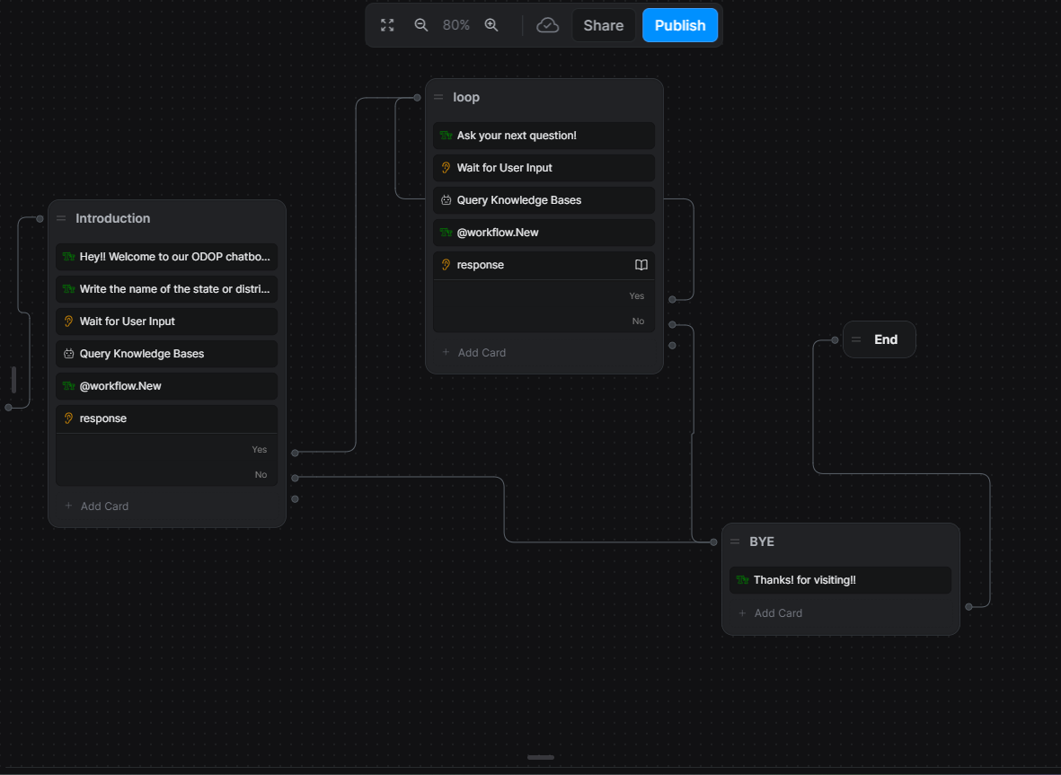
Add number of cart to maintain loop and get a seamless response ,and join all the nodes as per knowledge.
then change the name of our chatbot as by Setting.
After that publish the chatbot, and then share it.

Slide 17
WORKING OF ZUZU CHATBOT
ZUZU

Slide 18
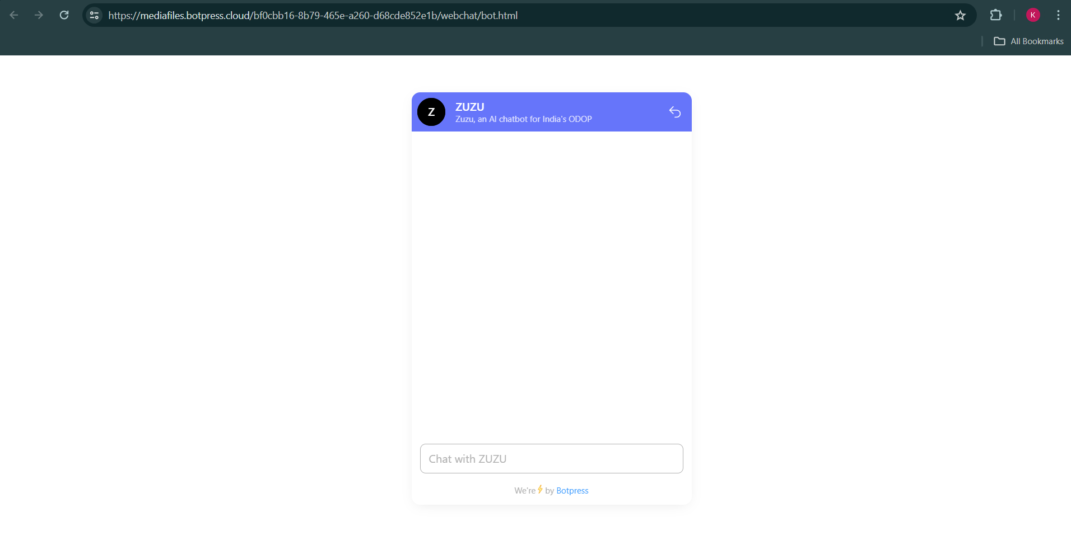
This the interface of zuzu chatbot

Slide 19
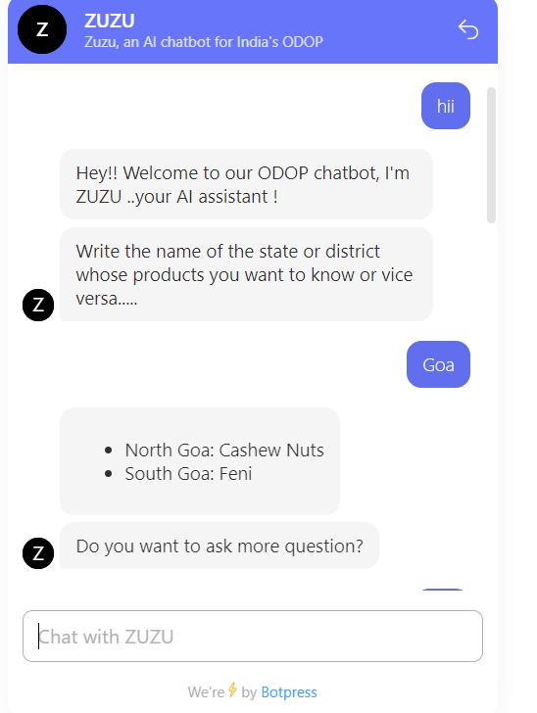
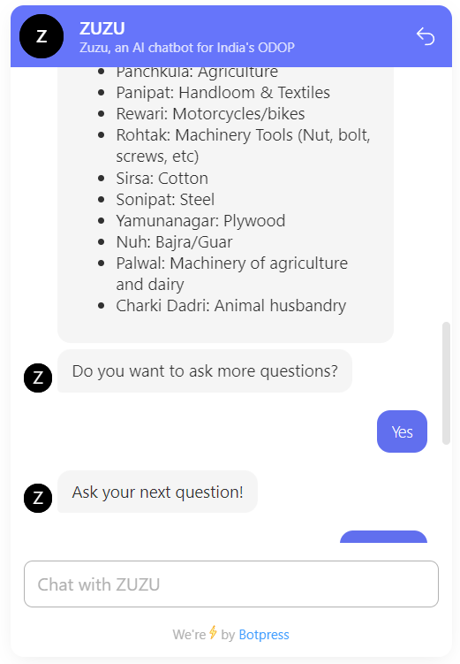
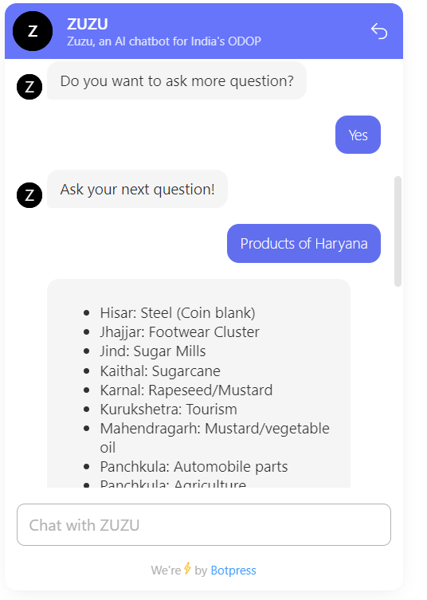
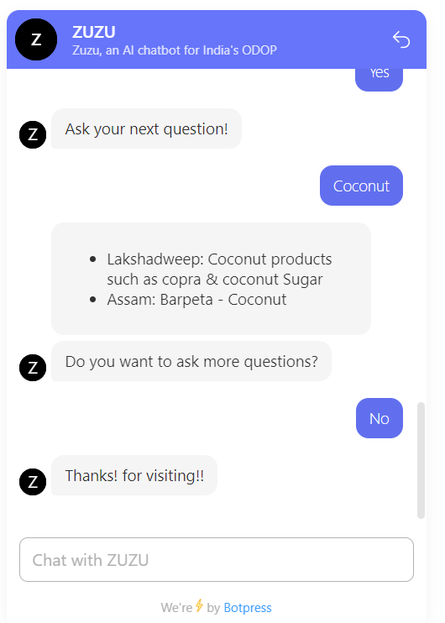
2
4
1
3

Slide 20
Thank
you!

